Slide 1
Chapter 2
Atoms, Molecules,
and Ions

Slide 2
2.1 The Early History of Chemistry
2.2 Fundamental Chemical Laws
2.3 Dalton’s Atomic Theory
2.4 Early Experiments to Characterize the Atom
2.5 The Modern View of Atomic Structure: An Introduction
2.6 Molecules and Ions
2.7 An Introduction to the Periodic Table
2.8 Naming Simple Compounds

Slide 3
Three Important Laws
Law of conservation of mass (Lavoisier):
  Mass is neither created nor destroyed.
Law of definite proportion (Proust):
  A given compound always contains exactly the same proportion of elements by mass.

Slide 4
Three Important Laws (continued)
Law of multiple proportions (Dalton):
  When two elements form a series of compounds, the ratios of the masses of the second element that combine with 1 gram of the first element can always be reduced to small whole numbers.

Slide 5
Dalton’s Atomic Theory (1808)
Each element is made up of tiny particles called atoms.

Slide 6
Dalton’s Atomic Theory (continued)
The atoms of a given element are identical; the atoms of different elements are different in some fundamental way or ways.

Slide 7
Dalton’s Atomic Theory (continued)
Chemical compounds are formed when atoms of different elements combine with each other. A given compound always has the same relative numbers and types of atoms.

Slide 8
Dalton’s Atomic Theory (continued)
Chemical reactions involve reorganization of the atoms—changes in the way they are bound together.
The atoms themselves are not changed in a chemical reaction.

Slide 9

Concept Check
Which of the following statements regarding Dalton’s atomic theory are still believed to be true?
Elements are made of tiny particles called atoms.
All atoms of a given element are identical.
A given compound always has the same relative
numbers and types of atoms.
IV. Atoms are indestructible.
Notes:
Statements I and III are true. Statement II is not true (due to isotopes and ions). Statement IV is not true (due to nuclear chemistry).

Slide 10
J. J. Thomson (1898—1903)
Postulated the existence of electrons using cathode-ray tubes.
Determined the charge-to-mass ratio of an electron.
The atom must also contain positive particles that balance exactly the negative charge carried by particles that we now call electrons.

Slide 11
Cathode-Ray Tube

Slide 12
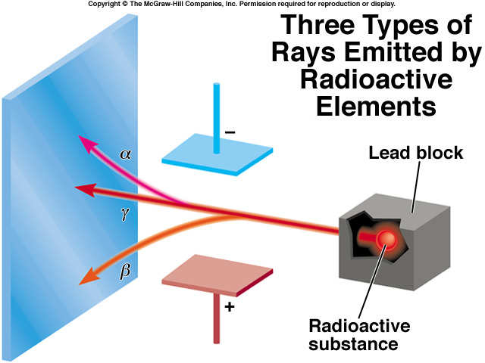
(Uranium compound)
2.2

Slide 13
Robert Millikan (1909)
Performed experiments involving charged oil drops.
Determined the magnitude of the charge on a single electron.
Calculated the mass of the electron.

Slide 14

Millikan Oil Drop Experiment

Slide 15
Ernest Rutherford (1911)
Explained the nuclear atom.
Atom has a dense center of positive charge called the nucleus.
Electrons travel around the nucleus at a relatively large distance.

Slide 16

Rutherford’s Gold Foil Experiment

Slide 17
The atom contains:
  Electrons – found outside the nucleus; negatively charged.
  Protons – found in the nucleus; positive charge equal in magnitude to the electron’s negative charge.
  Neutrons – found in the nucleus; no charge; virtually same mass as a proton.

Slide 18
The nucleus is:
  Small compared with the overall size of the atom.
  Extremely dense; accounts for almost all of the atom’s mass.

Slide 19
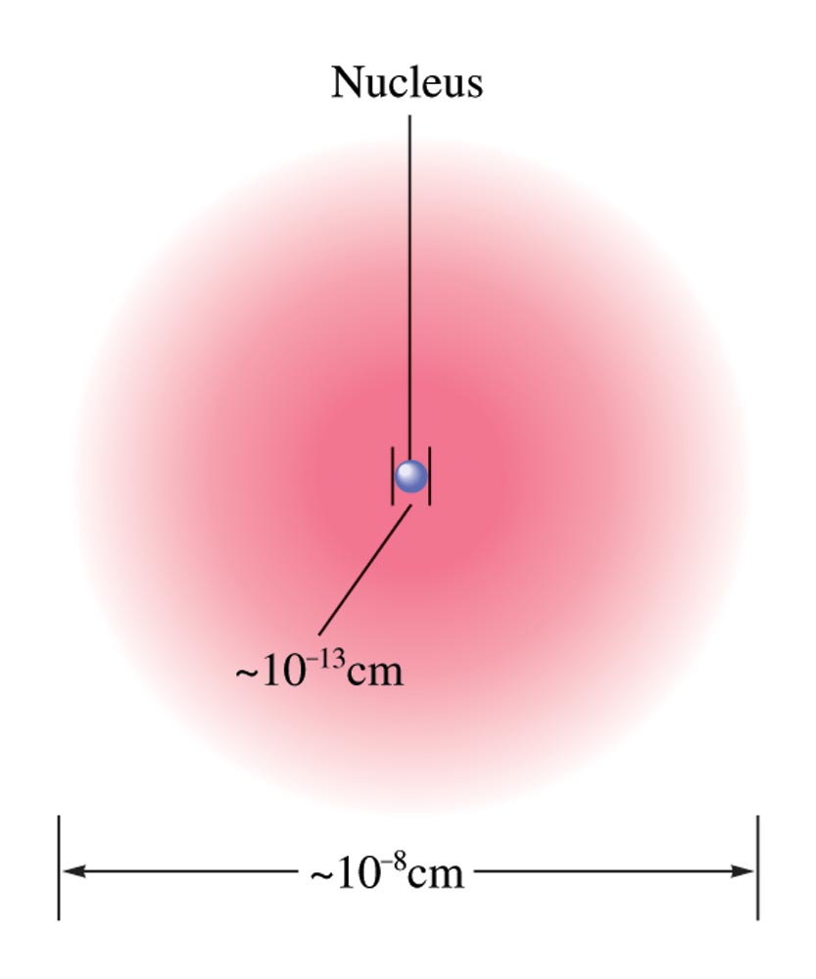
Nuclear Atom Viewed in Cross Section

Slide 20
Isotopes
Atoms with the same number of protons but different numbers of neutrons.
Show almost identical chemical properties; chemistry of atom is due to its electrons.
In nature most elements contain mixtures of isotopes.

Slide 21
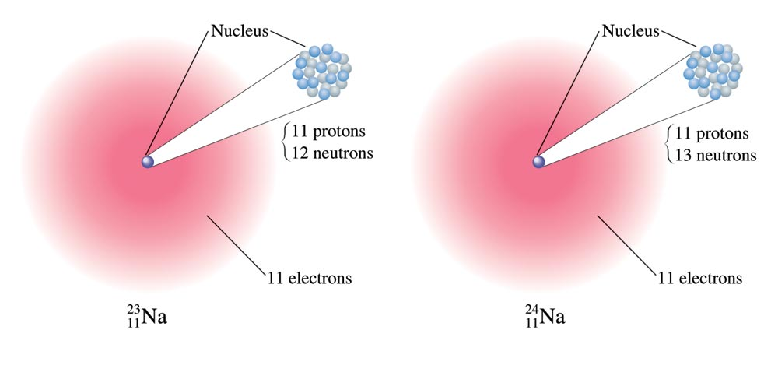
Two Isotopes of Sodium

Slide 22

Exercise
A certain isotope X contains 23 protons and 28 neutrons.
What is the mass number of this isotope?
Identify the element.
Mass Number = 51
Vanadium
Notes:
The mass number is 51. Mass Number = # protons + # neutrons. Mass Number = 23 + 28 = 51. The element is vanadium.

Slide 23
Chemical Bonds
Covalent Bonds
  Bonds form between atoms by sharing electrons.
  Resulting collection of atoms is called a molecule.

Slide 24

Covalent Bonding

Slide 25
Chemical Bonds
Ionic Bonds
  Bonds form due to force of attraction between oppositely charged ions.
  Ion – atom or group of atoms that has a net positive or negative charge.
  Cation – positive ion; lost electron(s).
  Anion – negative ion; gained electron(s).

Slide 26

Molecular vs. Ionic Compounds

Slide 27
Exercise
A certain isotope X⁺ contains 54 electrons and 78 neutrons.
What is the mass number of this isotope?
133
Notes:
The mass number is 133. The plus charge in X+ means that the ion has lost an electron, therefore the number of protons is 55 (54+1). The ion is Cs⁺ with a mass number of 133 (55+78).
Note: Use the red box animation to assist in explaining how to solve the problem.

Slide 28
The Periodic Table
Metals vs. Nonmetals
Groups or Families – elements in the same vertical columns; have similar chemical properties
Periods – horizontal rows of elements

Slide 29
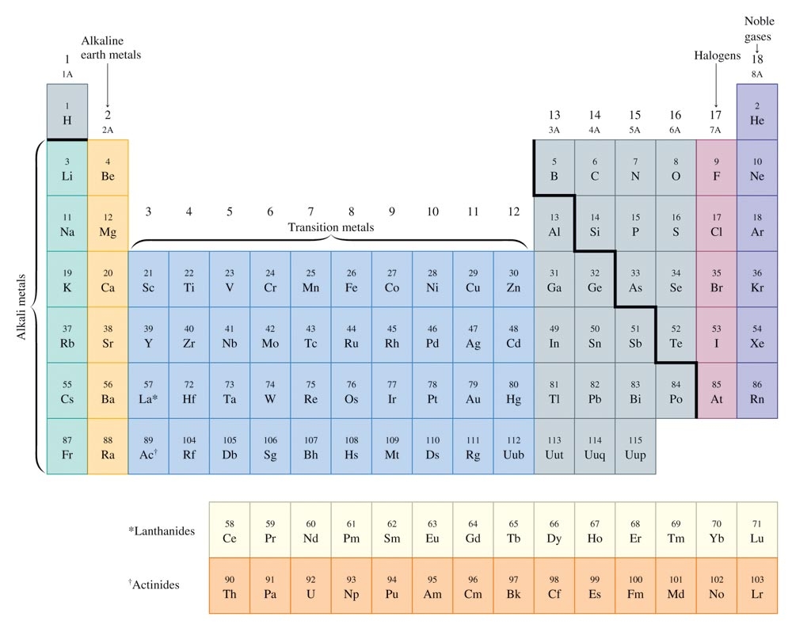
The Periodic Table

Slide 30
Groups or Families
Table of common charges formed when creating ionic compounds.
Group or Family | Charge
Alkali Metals (1A) | 1+
Alkaline Earth Metals (2A) | 2+
Halogens (7A) | 1–
Noble Gases (8A) | 0

Slide 31
Naming Compounds
Binary Compounds
  Composed of two elements
  Ionic and covalent compounds included
Binary Ionic Compounds
  Metal—nonmetal
Binary Covalent Compounds
  Nonmetal—nonmetal
Common Names only: H₂O & NH₃

Slide 32
Binary Ionic Compounds (Type I)
1. The cation is always named first and the anion second.
2. A monatomic cation takes its name from the name of the parent element.
3. A monatomic anion is named by taking the root of the element name and adding –ide.

Slide 33
Binary Ionic Compounds (Type I)
Examples:
KCl Potassium chloride
MgBr₂ Magnesium bromide
CaO Calcium oxide

Slide 34
Binary Ionic Compounds (Type II)
Metals in these compounds form more than one type of positive charge.
Charge on the metal ion must be specified.
Roman numeral indicates the charge of the metal cation.
Transition metal cations usually require a Roman numeral.

Slide 35
Binary Ionic Compounds (Type II)
Examples:
CuBr Copper(I) bromide
FeS Iron(II) sulfide
PbO₂ Lead(IV) oxide

Slide 36
Polyatomic Ions
Must be memorized (see Table 2.5 in text).
Examples of compounds containing polyatomic ions:
NaOH Sodium hydroxide
Mg(NO₃)₂ Magnesium nitrate
(NH₄)₂SO₄ Ammonium sulfate

Slide 37

Formation of Ionic Compounds

Slide 38
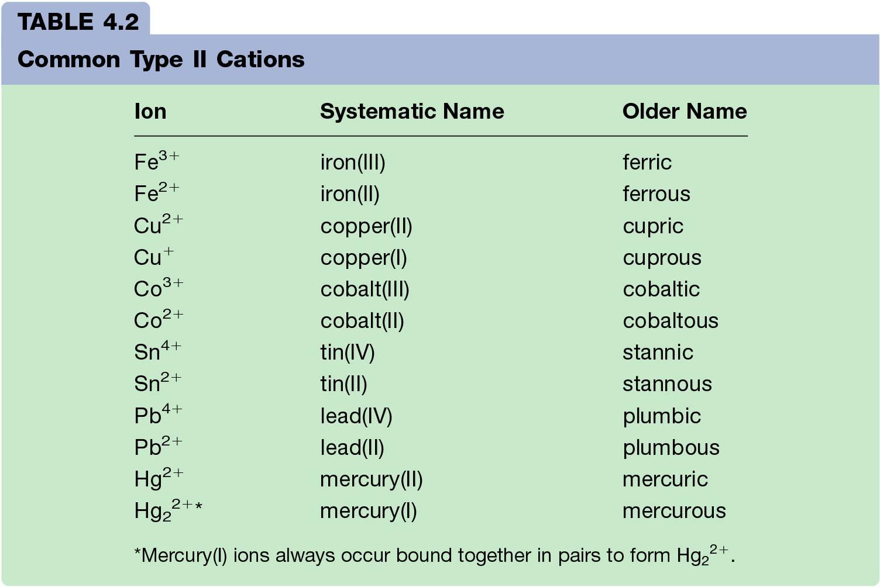
Examples of Older Names of Cations formed from Transition Metals
(just FYI… you don’t need these for the test except mercury(I) comes in pairs)
From Zumdahl HD book – NOT in AP book!!!

Slide 39
Binary Covalent Compounds (Type III)
Formed between two nonmetals.
1. The first element in the formula is named first, using the full element name.
2. The second element is named as if it were an anion (-ide).
3. Prefixes are used to denote the numbers of atoms present.
4. The prefix mono- is never used for naming the first element.

Slide 40
Prefixes Used to Indicate Number in Chemical Names

Slide 41
Binary Covalent Compounds (Type III)
Examples:
CO₂ Carbon dioxide
SF₆ Sulfur hexafluoride
N₂O₄ Dinitrogen tetroxide

Slide 42
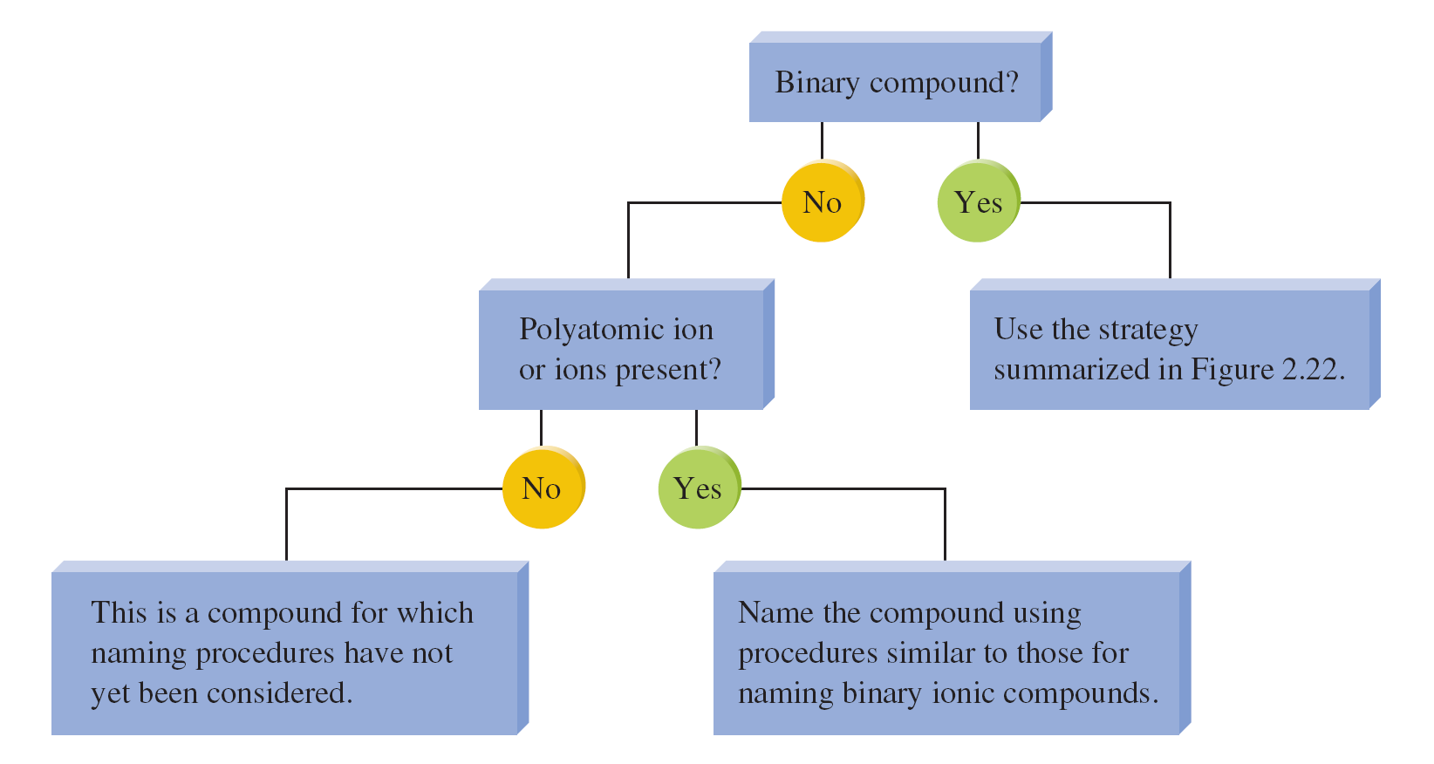
Overall Strategy for Naming Chemical Compounds

Slide 43
Flowchart for Naming Binary Compounds

Slide 44
Acids
Acids can be recognized by the hydrogen that appears first in the formula—HCl.
Molecule with one or more H⁺ ions attached to an anion.

Slide 45
Acids
If the anion does not contain oxygen, the acid is named with the prefix hydro– and the suffix –ic.
Must be dissolved in water to be an acid! (aq) or acid required – otherwise it’s a GAS
Examples:
HCl Hydrochloric acid
HCN Hydrocyanic acid
H₂S Hydrosulfuric acid

Slide 46
Acids
If the anion does contain oxygen:
  The suffix –ic is added to the root name if the anion name ends in –ate.
  Automatically acid – these gases do not exist
Examples:
HNO₃ Nitric acid
H₂SO₄ Sulfuric acid
HC₂H₃O₂ Acetic acid

Slide 47
Acids
If the anion does contain oxygen:
  The suffix –ous is added to the root name if the anion name ends in –ite.
  Automatically acid – these gases do not exist
Examples:
HNO₂ Nitrous acid
H₂SO₃ Sulfurous acid
HClO₂ Chlorous acid

Slide 48
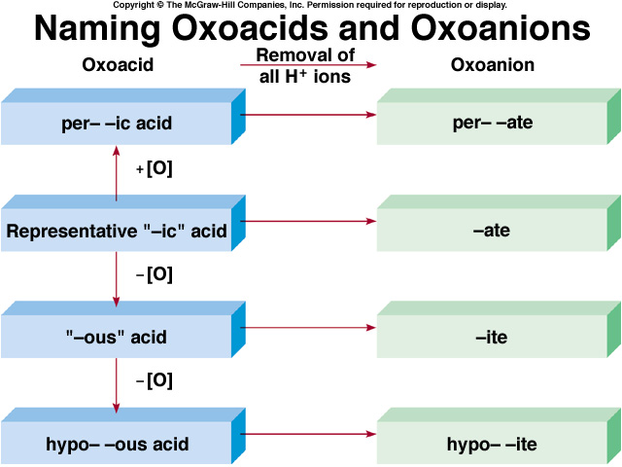
2.7

Slide 49
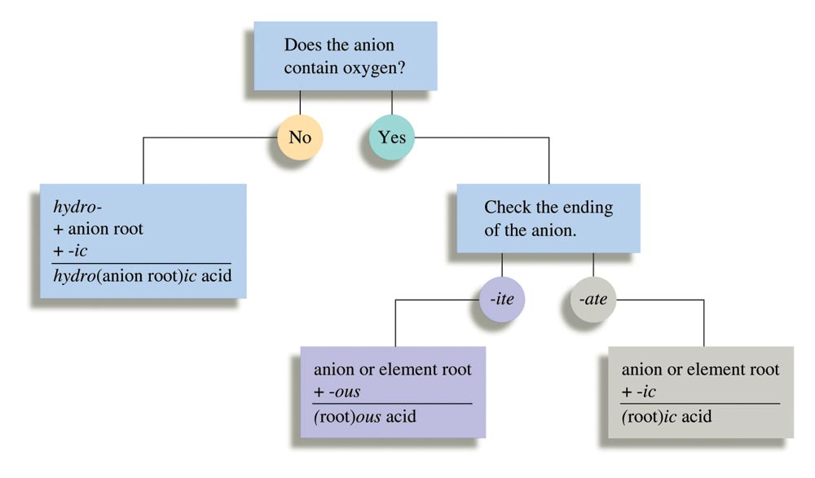
Flowchart for Naming Acids

Slide 50
Exercise
Which of the following compounds is named incorrectly?
KNO₃ potassium nitrate
TiO₂ titanium(II) oxide
Sn(OH)₄ tin(IV) hydroxide
PBr₅ phosphorus pentabromide
CaCrO₄ calcium chromate
Notes:
The correct answer is “b”. The charge on oxygen is 2-. Since there are two oxygen atoms, the overall charge is 4-. Therefore, the charge on titanium must be 4+ (not 2+ as the Roman numeral indicates).

Slide 51
Mixed Practice
Dinitrogen monoxide
Potassium sulfide
Copper (II) nitrate
Dichlorine heptoxide
Chromium (III) sulfate
Iron(III) sulfite
Calcium oxide
Barium carbonate
Iodine monochloride
N₂O
K₂S
Cu(NO₃)₂
Cl₂O₇
Cr₂(SO₄)₃
Fe₂(SO₃)₃
CaO
BaCO₃
ICl

Slide 52
Mixed Practice
BaI₂
P₄S₃
Ca(OH)₂
FeCO₃
Na₂Cr₂O₇
I₂O₅
Cu(ClO₄)₂
CS₂
B₂Cl₄
Barium iodide
Tetraphosphorus trisulfide
Calcium hydroxide
Iron (II) carbonate
Sodium dichromate
Diiodine pentoxide
Copper(II) perchlorate
Carbon disulfide
Diboron tetrachloride

